Slide 1
Presentation on Wavelet, Special Effects and Video Processing
Presented to
Professor Dr. Liton Jude Rozario
Department of Computer Science & Engineering
Jahangirnagar University
Savar, Dhaka
Presented by
Tama Shil (342)
Md Minhaj Uddin (368)
Pritam Saha(375)

Slide 2
Wavelet Transform

Slide 3
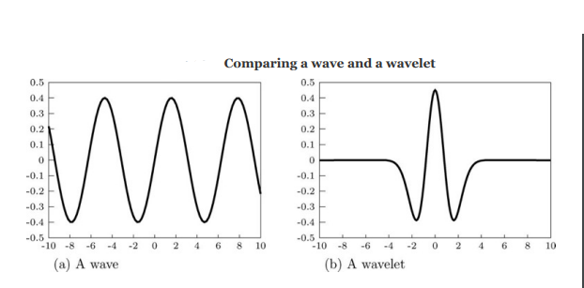
Wavelet Transform
A wavelet transform decomposes a signal into a set of basic functions.
These basic functions are called the “wavelets”
A wavelet to be a little part of a wave: a wave which is only non-zero in a small region
So we can say a Wavelet transform is the decomposition of a signal to the frequency components.

Slide 4
Applications of Wavelet Transform
In this topic we will try to discuss about
Image Compression Using Wavelets
Approximation and detail coefficients
High Pass Filtering Using Wavelets
Denoising Using Wavelets

Slide 5
Image Compression using wavelet transform
Why use wavelet transform in image compression-
Wavelet transform is used in image compression to analyze an image in terms of its frequency components and spatial information.
This allows for effective data reduction while maintaining a balance between compression ratio and image quality.
Image compression is the process of reducing the size of an image file while trying to preserve its visual quality as much as possible.
Here we will use different wavelets like Haar wavelet and Daubechies-6 wavelet for compression

Slide 6
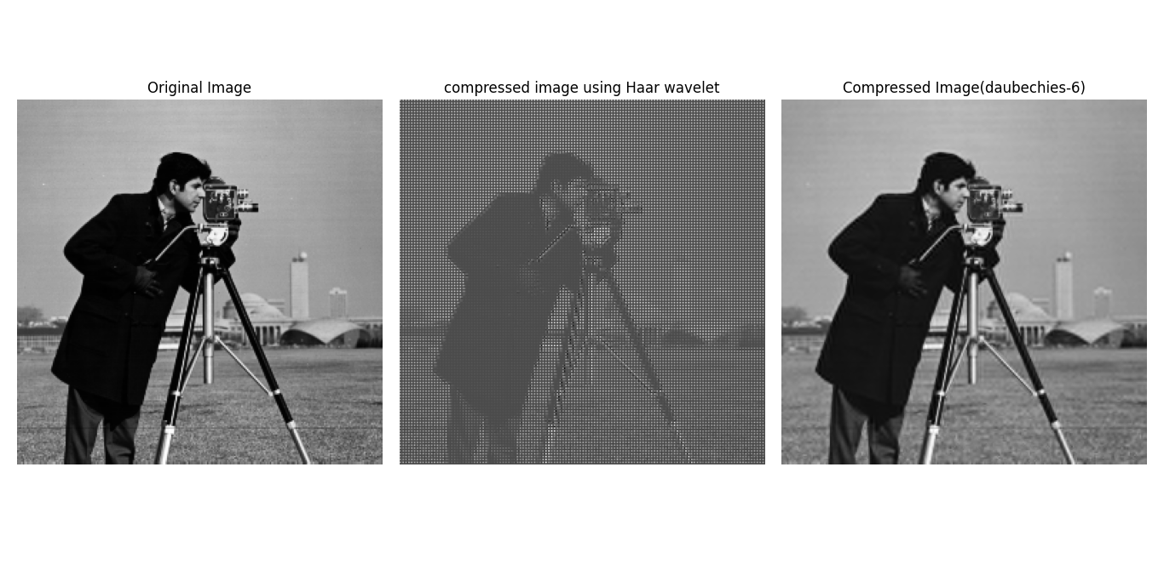
Image Compression using wavelet transform
Python code:
# Perform Haar wavelet transform
transformed_image = haar_wavelet_transform(image)
# Perform Daubechies-6 wavelet transform
coeffs = pywt.dwt2(original_image, 'db6')
approximation, (horizontal_detail, vertical_detail, diagonal_detail) = coeffs
compression_threshold = 20
horizontal_detail_thresholded = pywt.threshold(horizontal_detail, compression_threshold, mode='soft')
vertical_detail_thresholded = pywt.threshold(vertical_detail, compression_threshold, mode='soft')
diagonal_detail_thresholded = pywt.threshold(diagonal_detail, compression_threshold, mode='soft')
compressed_image_coeffs = (approximation, (horizontal_detail_thresholded, vertical_detail_thresholded, diagonal_detail_thresholded))
compressed_image = pywt.idwt2(compressed_image_coeffs, 'db6')

Slide 7
Approximation and detail coefficients
Python code:
image_path = 'D://Dataset//5.3.01.tiff'
image = io.imread(image_path, as_gray=True)
coeffs = pywt.dwt2(image, 'haar')
cA, (cH, cV, cD) = coeffs
cA_log = np.log10(1 + np.abs(cA))
cH_log = np.log10(1 + np.abs(cH))
cV_log = np.log10(1 + np.abs(cV))
cD_log = np.log10(1 + np.abs(cD))
plt.figure(figsize=(12, 6))
Here we will perform a Discrete Wavelet Transform (DWT) on an image using the Haar wavelet and visualize its approximation and detail coefficients.

Slide 8
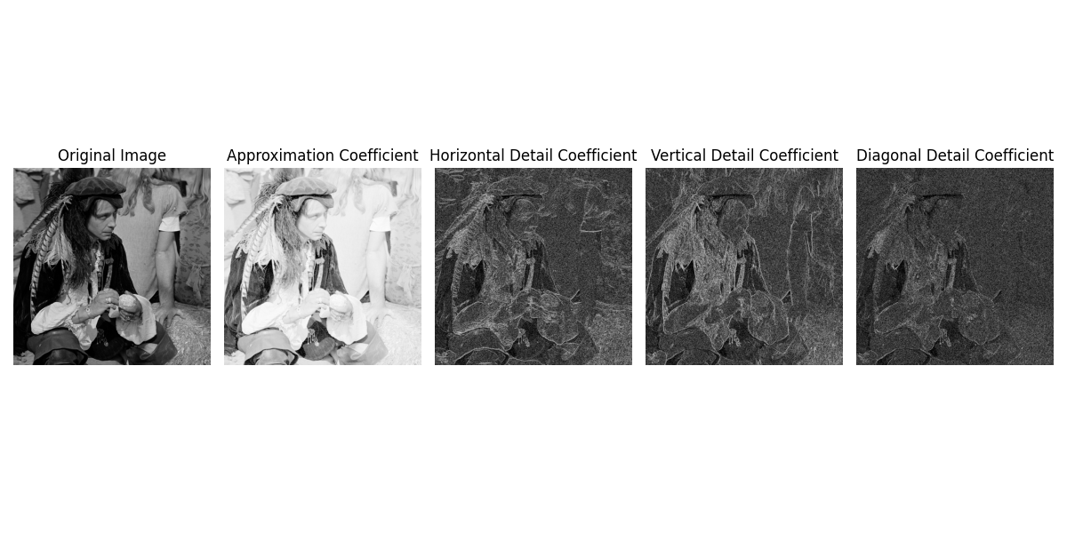

Slide 9
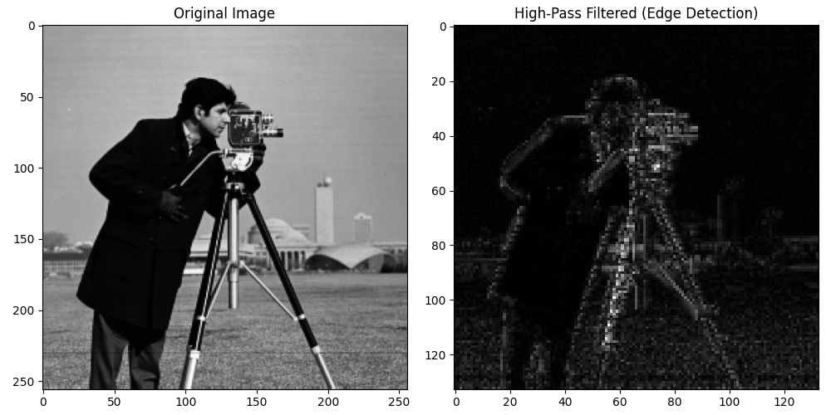
High Pass Filtering Using Wavelets
Python code:
coeffs = pywt.dwt2(gray_image, 'db6')
_, (horizontal_detail, vertical_detail, diagonal_detail) = coeffs
high_pass_filtered = np.sqrt(horizontal_detail**2 + vertical_detail**2 + diagonal_detail**2)
If we look at a wavelet transform, then apart from the rescaled image in the top left, the rest is high frequency information.
We would expect then, that if we were to eliminate the top left corner, by setting all the transform values to zero, the result after inversion would be a high pass filtered version of the original image.

Slide 10
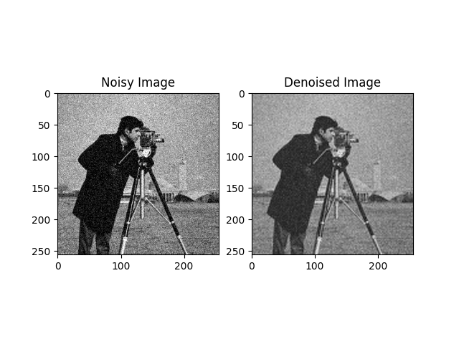
We will use low pass filtering to remove noises from image as noise can be considered a high frequency component
we can remove such components by thresholding
Denoising Using Wavelets
Python code:
noisy_image = random_noise(original_image, mode='gaussian', var=0.01)
coeffs = pywt.dwt2(noisy_image, 'db6')
approximation, detail_coeffs = coeffs
sigma = 0.9
denoised_detail_coeffs = [denoise_wavelet(detail, wavelet='db6', mode='soft', wavelet_levels=3, sigma=sigma) for detail in detail_coeffs]
denoised_image = pywt.idwt2((approximation, denoised_detail_coeffs), 'db6')

Slide 11
Special Effect

Slide 12
Special Effect
In this session, we will explore special effects.
Special effects are a key component of modern image processing, adding creativity and uniqueness to images.
Special effects refer to various techniques used to manipulate images in ways that go beyond traditional enhancement.
We may want to do this for effect alone, or simply for fun.

Slide 13
Special Effect
There are many different effects possible, and here we shall look at a few of them-
Radial pixilation
Ripple Effects
General Distortion Effects(Fisheye and twirls, Jitter and circular slice, The fuzzy effect, Jitter and circular slice, The fuzzy effect )
Pixel Effects(The oil painting effect, solarization effect)

Slide 14
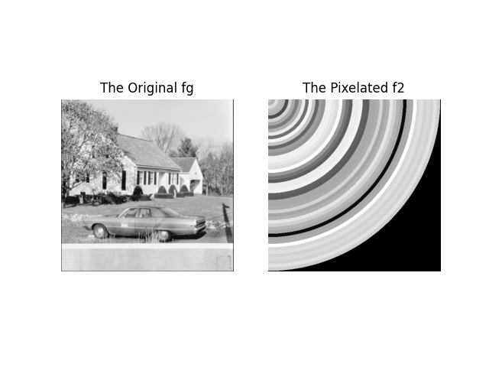
Radial pixelation
Python code:
fg = color.rgb2gray(f)
ox = oy = 0
rows, cols = fg.shape
y, x = np.indices((rows, cols))
r = np.sqrt((x - ox)**2 + (y - oy)**2)
step = 10
x2 = (r // step) * step + step // 2,y2 = x2
x2 = np.clip(x2, 0, cols - 1).astype(int)
y2 = np.clip(y2, 0, rows - 1).astype(int)
f2 = fg[y2, x2]
Fig: Radial pixelation

Slide 15
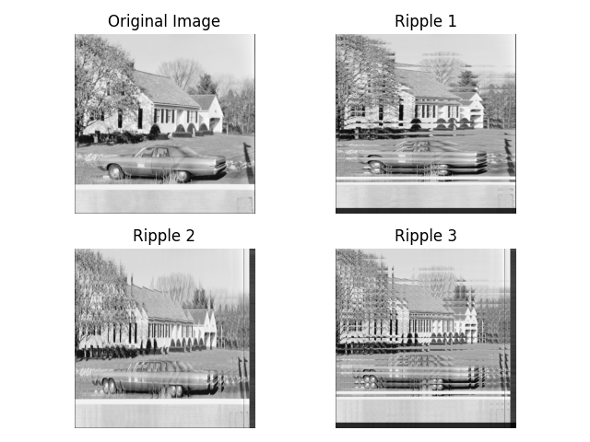
Ripple Effects
Python code:
fg = color.rgb2gray(f)
y, x = np.indices((cols, rows))
x2 = clip(x + x % 32, 0, rows - 1)
ripple1 = np.reshape(fg[x2.ravel(), y.ravel()], (cols, rows)).T
y2 = clip(y + y % 32, 0, cols - 1)
ripple2 = np.reshape(fg[x.ravel(), y2.ravel()], (rows, cols)).T
y3 = clip(y + y % 32, 0, cols - 1)
ripple3 = np.reshape(fg[x2.ravel(), y3.ravel()], (cols, rows)).T
Fig: Ripple Effects

Slide 16
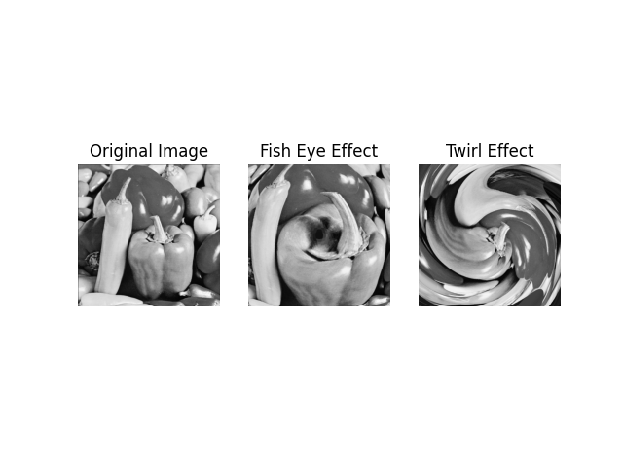
General Distortion Effects Fisheye and twirls
Python code:
#FishEye
r,theta,ox,oy = polarmesh(fg)
s=r**2/r.max()
f2=polar2im(s,theta,fg)
#Twirl
K=100
phi=theta+(r/K)
twirl=polar2im(r,phi,fg)
Fig: Fisheye and twirls effects

Slide 17
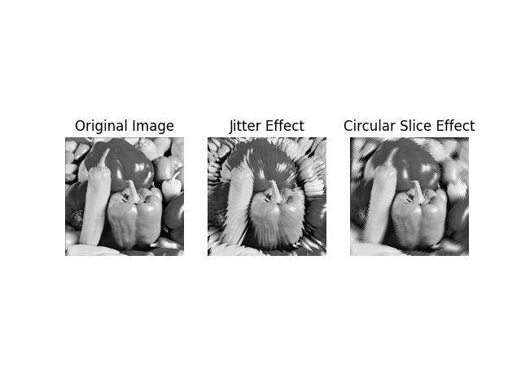
General Distortion Effects Jitter and circular slice
Python code:
#Jitter Effect
phi=theta+(theta%(8*np.pi/180))-4*np.pi/180
jitter=polar2im(r,phi,fg)
#Circular Slice
phi=theta+((r%6)*(np.pi/180))
circularSlice=polar2im(r,phi,fg)
Fig: Jitter and circular slice effects

Slide 18
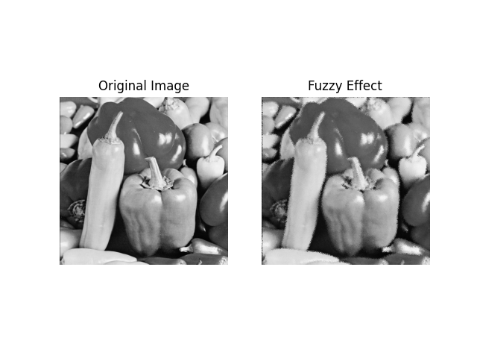
General Distortion Effects The fuzzy effect
Python code:
#Fuzzy Effect
x2=x+np.random.randint(-3,3,size=(rows,cols))
y2=y+np.random.randint(-3,3,size=(rows,cols))
x2=clip(x2,0,rows-1).astype(int)
y2=clip(y2,0,cols-1).astype(int)
f2=np.reshape(fg[x2.ravel(),y2.ravel()],(rows,cols)).T
Fig: The fuzzy effect

Slide 19
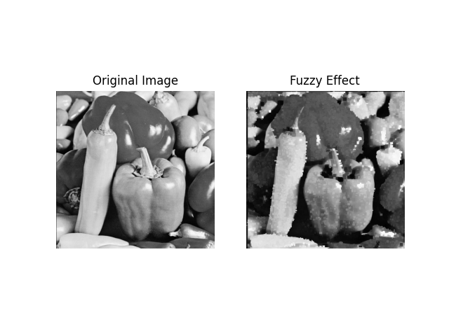
Pixel Effects The oil painting effect
Python code:
#oil paint effect
def mymode(x):
return stats.mode(x, axis=None,
keepdims=True)[0][0]
f2 = ndi.generic_filter(fg, mymode, size=(9, 9))
Fig: The oil painting effect with different filter size 9x9

Slide 20
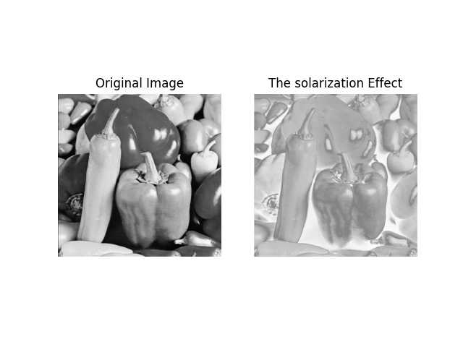
Pixel Effects The solarization effect
Python code:
#The solarization effect
u=fg>0.5
sol=u*fg+(1-u)*(1-fg)
plt.imshow(sol,vmin=0,vmax=1, cmap='gray')
plt.title('The solarization Effect')
Fig: The solarization effect

Slide 21
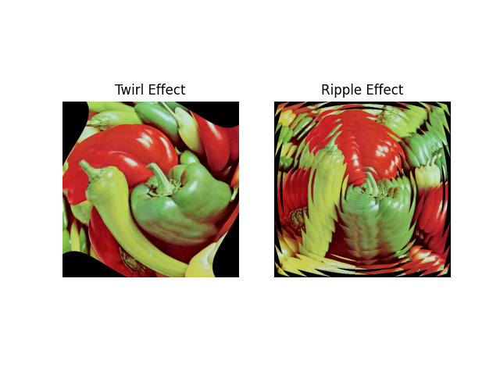
Pixel Effects The color effect
Python code:
#The color effect
r, theta = polarmesh(fg)
k = 250
phi = theta + r / k
r2 = r + (r % 30)
twirl = np.zeros_like(f)
ripple = np.zeros_like(f)
for i in range(3):
twirl[:, :, i] = polar2im(f[:, :, i], r, phi)
ripple[:, :, i] = polar2im(f[:, :, i], r2, theta)
Fig: The COLOR INSERT Effects on a color image

Slide 22
Video Processing

Slide 23
Video Processing
Video processing is a fundamental branch of digital image processing that deals with the manipulation, analysis, and enhancement of video sequences.
It involves a series of techniques aimed at extracting meaningful information from video data, making it a crucial field in today's digital world.

Slide 24
Video Processing
Here we will cover –
Output of live webcam feed
Grayscale video of RGB color video
Separating color channels in a a live webcam stream
More operations on live webcam streams

Slide 25
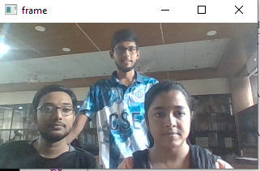
Output of live webcam feed
Python code:
cap = cv.VideoCapture(0)
cap.set(cv.CAP_PROP_FRAME_WIDTH, 256)
cap.set(cv.CAP_PROP_FRAME_HEIGHT, 144)
successfully
if not cap.isOpened():
print("Cannot open camera...")
exit()
while True:
ret, frame = cap.read()
if not ret:
print("Can't receive... \nExiting ...")
break
cv.imshow('frame', frame)
if cv.waitKey(1) == 27:
break
Output of live webcam feed

Slide 26
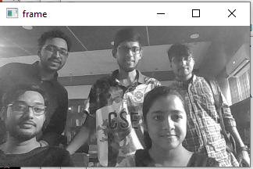
Grayscale video of RGB color video
Python code:
if not cap.isOpened():
print("Cannot open camera...")
exit()
while True:
ret, frame = cap.read()
if not ret:
break
gray = cv.cvtColor(frame, cv.COLOR_BGR2GRAY)
cv.imshow('frame', gray)
if cv.waitKey(1) == 27:
break
cap.release()
cv.destroyAllWindows()
Fig: Separating color channels in a live webcam stream

Slide 27
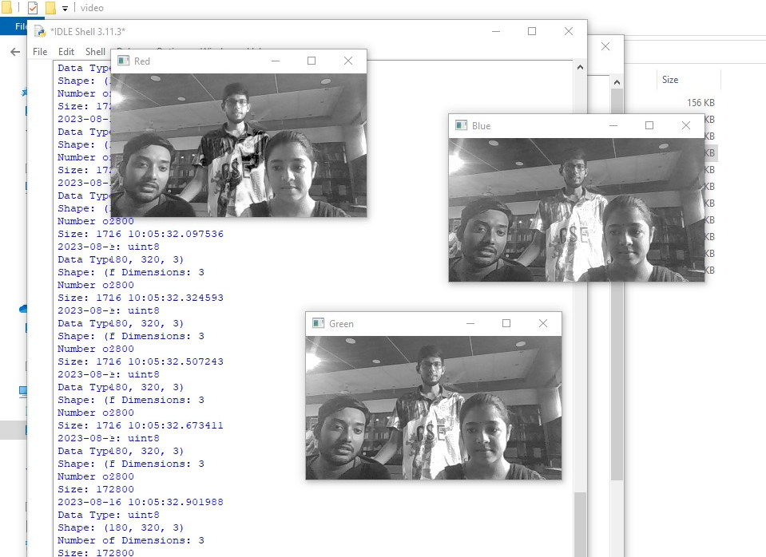
Separating color channels in a live webcam stream
Python Code:
b = frame[:, :, 0]
g = frame[:, :, 1]
r = frame[:, :, 2]
cv.imshow('Red', r)
cv.imshow('Green', g)
cv.imshow('Blue', b)
if cv.waitKey(1) == 27:
break
cap.release()
cv.destroyAllWindows()
Fig: Separating color channels in a live webcam stream

Slide 28
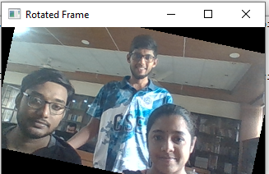
Some More operations on live webcam streams: Geometric Transformation
Python code:
if not cap.isOpened():
print("Cannot open camera...")
exit()
while True:
ret, frame = cap.read()
if not ret:
break
angle = (angle + 1) % 360
output = ndi.rotate(frame, angle, reshape=False)
cv.imshow('Rotated Frame', output)
if cv.waitKey(1) == 27:
break
Fig: Geometric Transformation of a live webcam feed

Slide 29
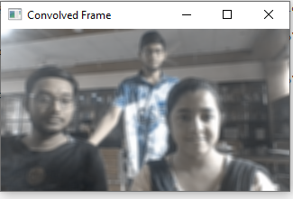
Some More operations on live webcam streams: Convolution
Python code:
while True:
ret, frame = cap.read()
if not ret:
break
output = ndi.convolve(frame, k, mode='nearest')
cv.imshow('Convolved Frame', output)
if cv.waitKey(1) == 27:
break
cap.release()
cv.destroyAllWindows()
Fig: Blured fig from webcam

Slide 30
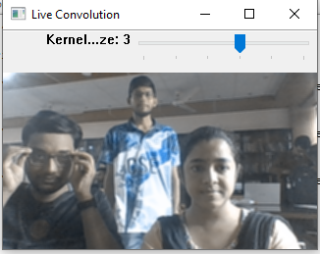
Some More operations on live webcam streams: Convulation(Using Trackbar)
Python code:
while True:
ret, frame = cap.read()
if not ret:
print("Can't receive frame... \nExiting ...")
break
n = cv.getTrackbarPos('Kernel Size', WINDOW_NAME)
k = np.ones((n, n, n), np.uint8) / (n * n * n)
output = ndi.convolve(frame, k, mode='nearest')
if cv.waitKey(1) == 27: break
Fig: Using trackbar

Slide 31
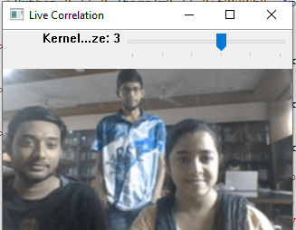
Some More operations on live webcam streams: Correlation
Python Code:
while True:
ret, frame = cap.read()
if not ret:
print("Can't receive frame... \nExiting ...")
break
n = cv.getTrackbarPos('Kernel Size', WINDOW_NAME)
k = np.ones((n, n, n), np.uint8) / (n * n * n)
output = ndi.correlate(frame, k, mode='nearest')
if cv.waitKey(1) == 27: break
Fig: Correlation with trackbar

Slide 32
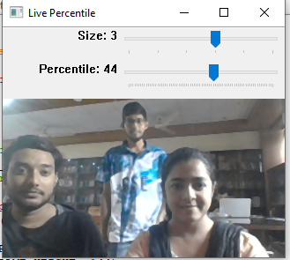
Some More operations on live webcam streams: Filtering
Python code:
while True:
ret, frame = cap.read()
if not ret:
print("Can't receive frame... \nExiting ...")
break
s = cv.getTrackbarPos('Size', WINDOW_NAME)
p = cv.getTrackbarPos('Percentile', WINDOW_NAME)
output = ndi.percentile_filter(frame, size=s, percentile=p)
cv.imshow(WINDOW_NAME, output)
if cv.waitKey(1) == 27: break
Fig: Percentile filter

Slide 33
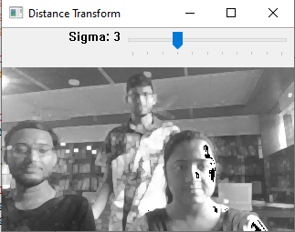
Some More operations on live webcam streams: Morphological Operation (Grayscale dilation)
Python Code:
while True:
ret, frame = cap.read()
if not ret:
print("Can't receive frame... \nExiting ...")
break
grey = cv.cvtColor(frame,cv.COLOR_BGR2GRAY)
n1 = cv.getTrackbarPos('Sigma',WINDOW_NAME)
output = ndi.grey_dilation(grey, size=(7, 7), structure=np.ones((n1, n1)))
cv.imshow(WINDOW_NAME, output)
if cv.waitKey(1) == 27: break
fig: Grayscale dilation

Slide 34
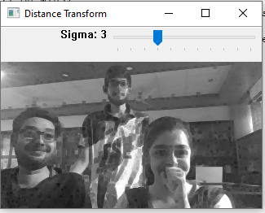
Some More operations on live webcam streams: Morphological Operation (Grayscale Erosion)
Python Code:
while True:
ret, frame = cap.read()
if not ret:
break
grey = cv.cvtColor(frame, cv.COLOR_BGR2GRAY)
n1 = cv.getTrackbarPos('Sigma', WINDOW_NAME)
output = ndi.grey_erosion(grey, size=(7, 7), structure=np.ones((n1, n1)))
if cv.waitKey(1) == 27:
break
cap.release()
cv.destroyAllWindows()
fig: Grayscale erosion

Slide 35
Thank You

